Slide 1
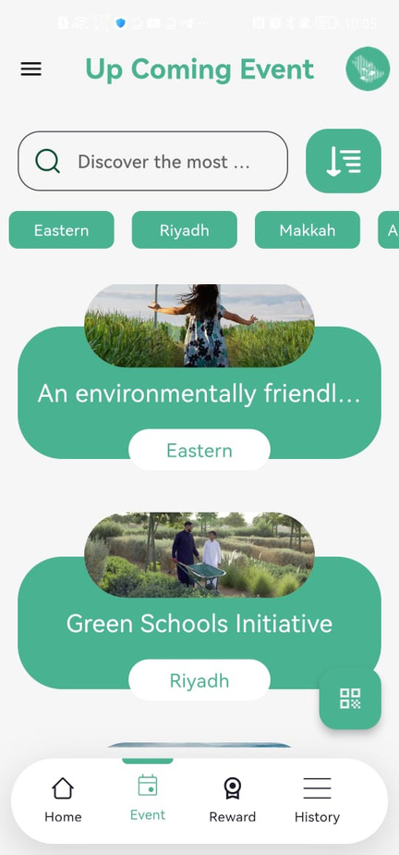

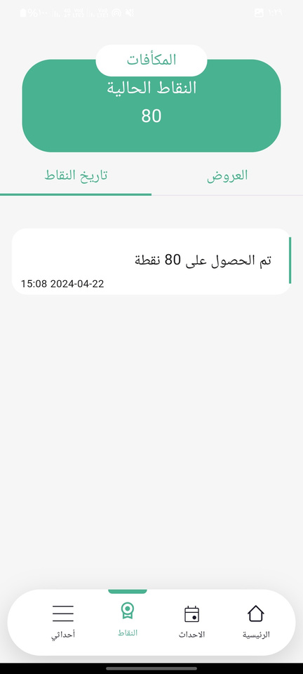
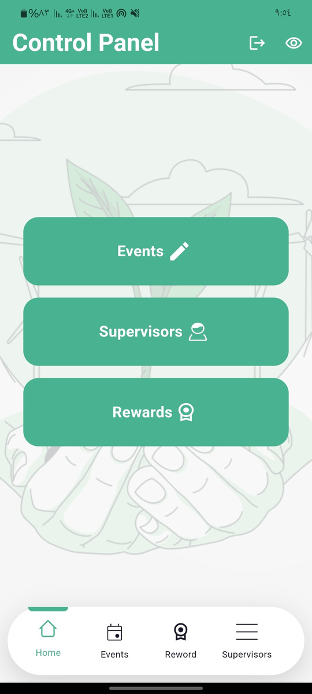
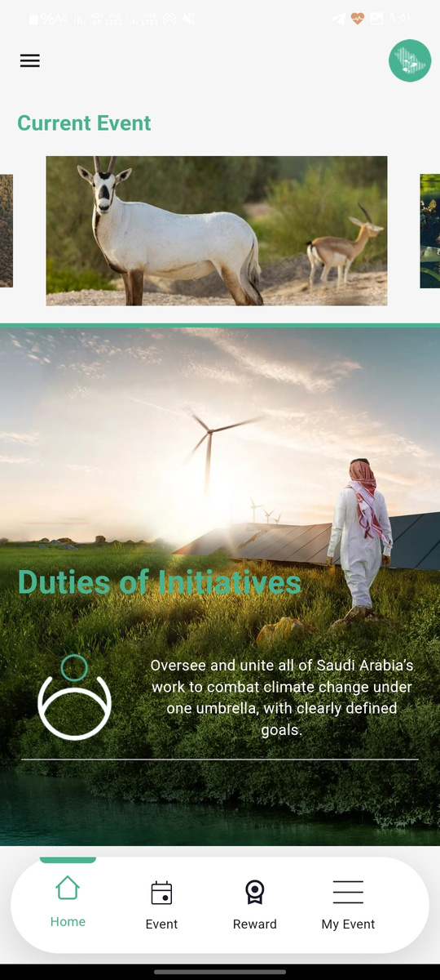
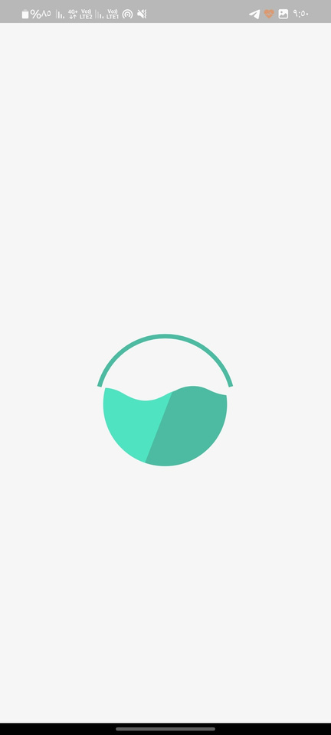
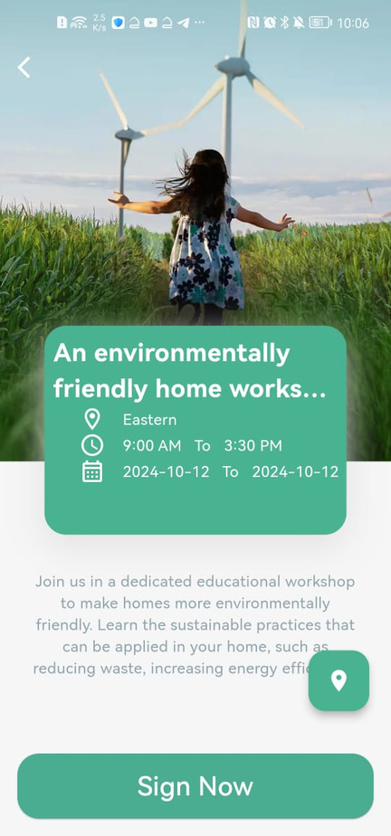
Saudi Green APP
IMPROVE NATURE & CLIMATE

Slide 2


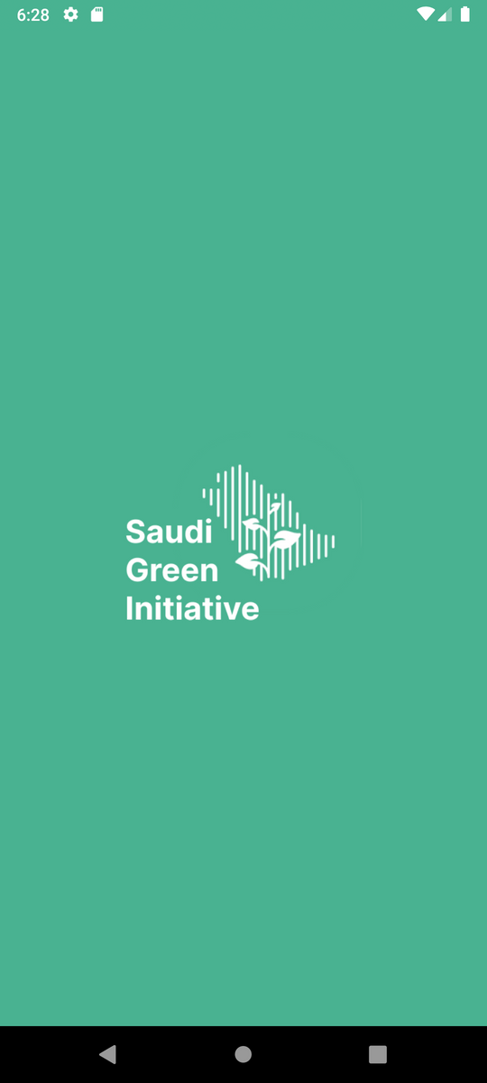
MASS FLUTTER
Saad Alharbi
Sultan Alotibi
Abdulwahab Alaql
Mohammed Alzahrani

Slide 3
CONTENT
01.
02.
03.
04.
OPENING
ABOUT APP
DESIGN
END SLIDE

Slide 4
INTRODUCTION
THE GREEN SAUDI APP OFFERS SEVERAL INITIATIVES TO IMPROVE THE QUALITY OF NATURE AND THE CLIMATE, ALLOWING INDIVIDUALS TO PARTICIPATE IN THESE INITIATIVES AND RECEIVE REWARDS
LETS GET STARTED

Slide 5
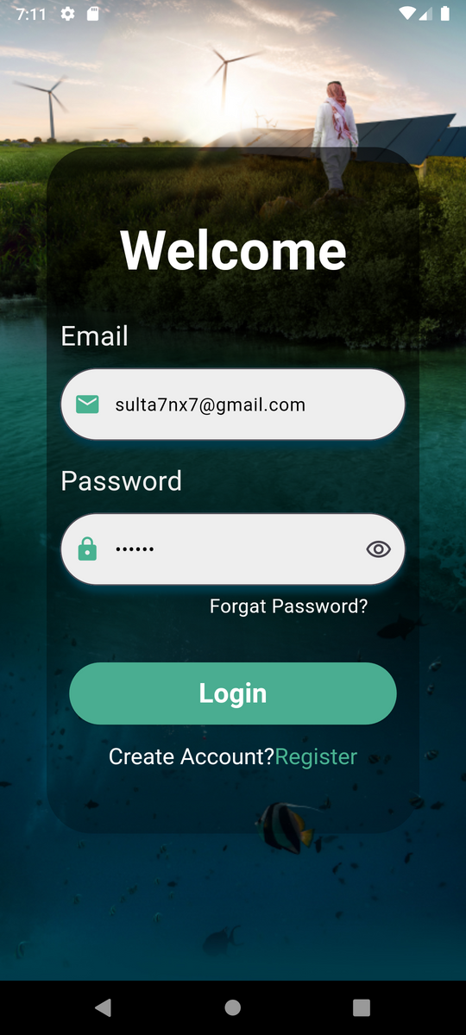
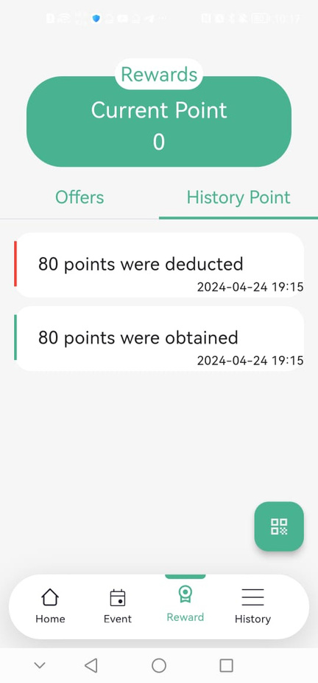


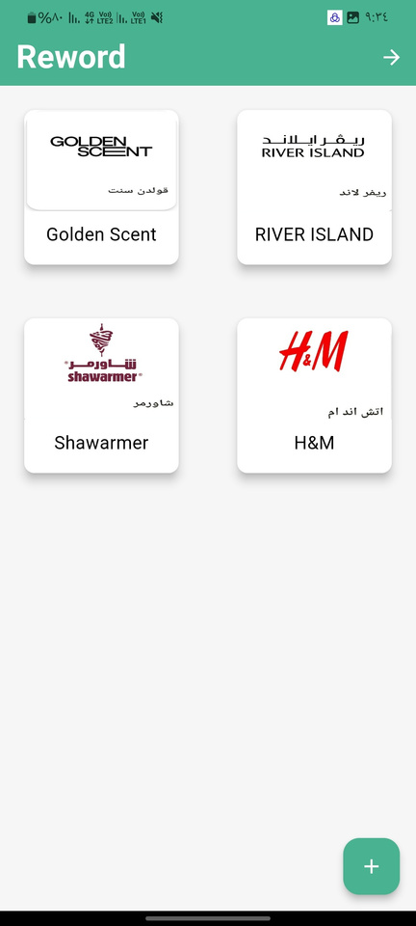

OUR PURPOSE
MAKING THIS APP
PROMOTING ENVIRONMENTAL SUSTAINABILITY
ENCOURAGING COMMUNITY INVOLVEMENT
FOSTERING A CULTURE OF CONSERVATION

Slide 6

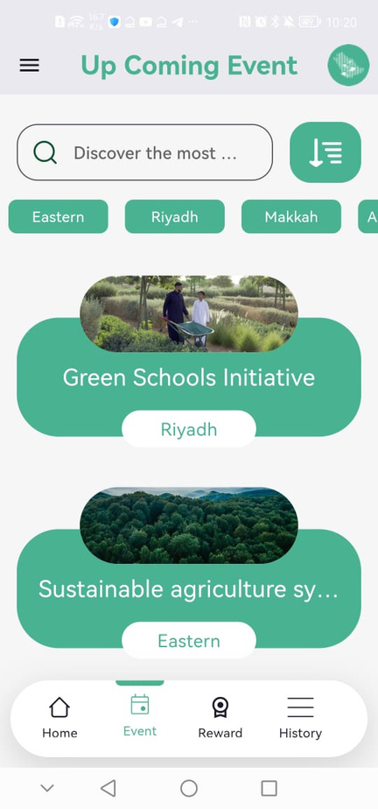


INTRODUCING
GSI APP
GREEN INITIATIVES
EARN REWARDS
Access a variety of initiatives aimed at improving nature and the climate.
Get rewarded for your contribution to environmental sustainability.
USER PARTICIPATION
USER-FRIENDLY
Users can actively participate in various environmental projects.
Easy-to-use interface for a seamless experience.

Slide 7
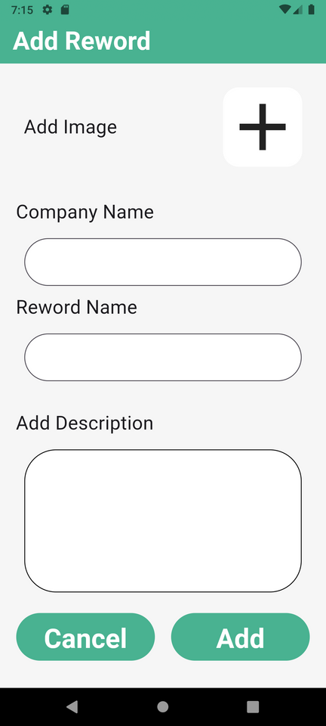
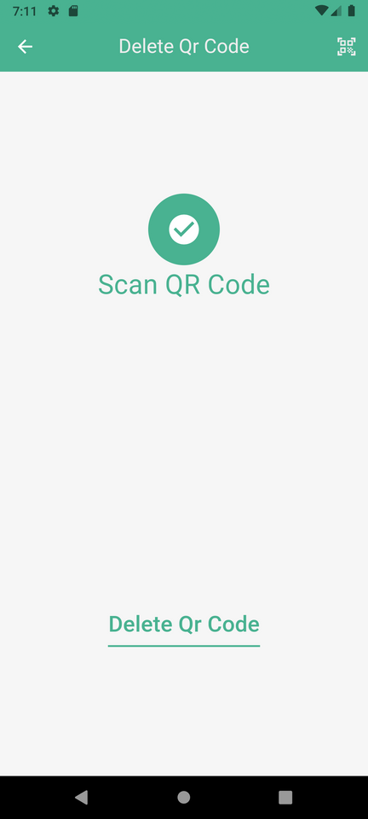


PROVIDE FEATURE
IN MOBILE ?
SCAN QR CODE ATTENDEES
Scan QR code for attendee check-in.
REWARD MANGMENT
Reward system for active participation.
APPEARANCE
Dark mode for comfortable viewing.

Slide 8
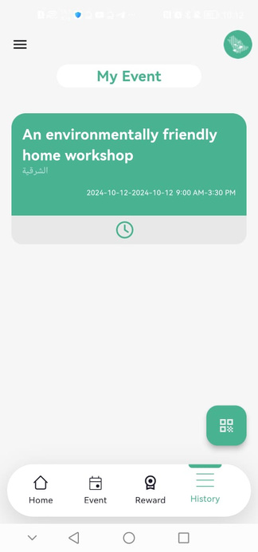
APP USAGE
ACCESS A VARIETY OF GREEN INITIATIVES
EARN REWARDS FOR CONTRIBUTIONS
ENGAGE WITH A LIKE-MINDED COMMUNITY
RECEIVE REAL-TIME UPDATES
CUSTOMIZE YOUR EXPERIENCE

Slide 9




ESSENTIAL TOOLS: A JOURNEY THROUGH OUR PROJECT"?
FLUTTER
FIGMA
SUBABASE
MONDAY

Slide 10
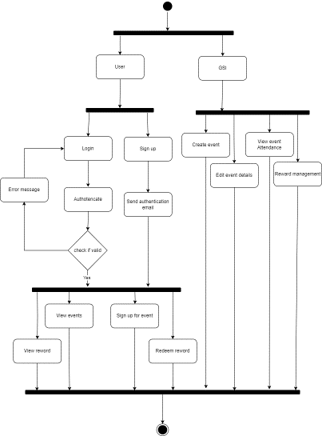
ACTIVITY DIAGRAM

Slide 11
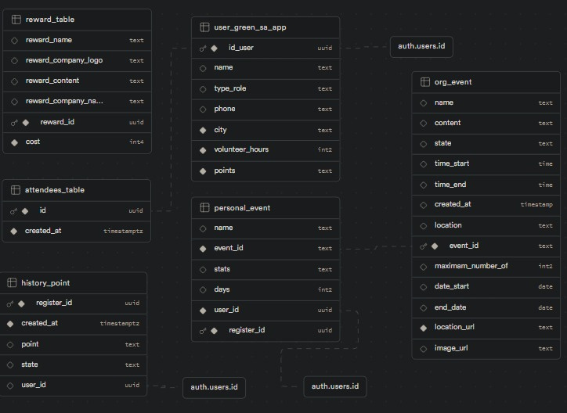
DATABASE

Slide 12
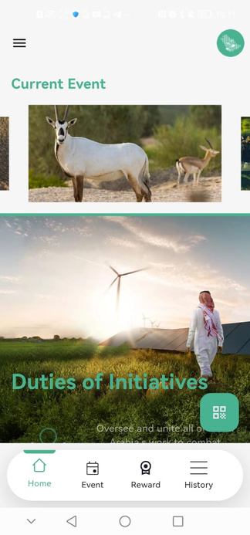

User Perspective
THROUGH THE USER'S EYES

Slide 13
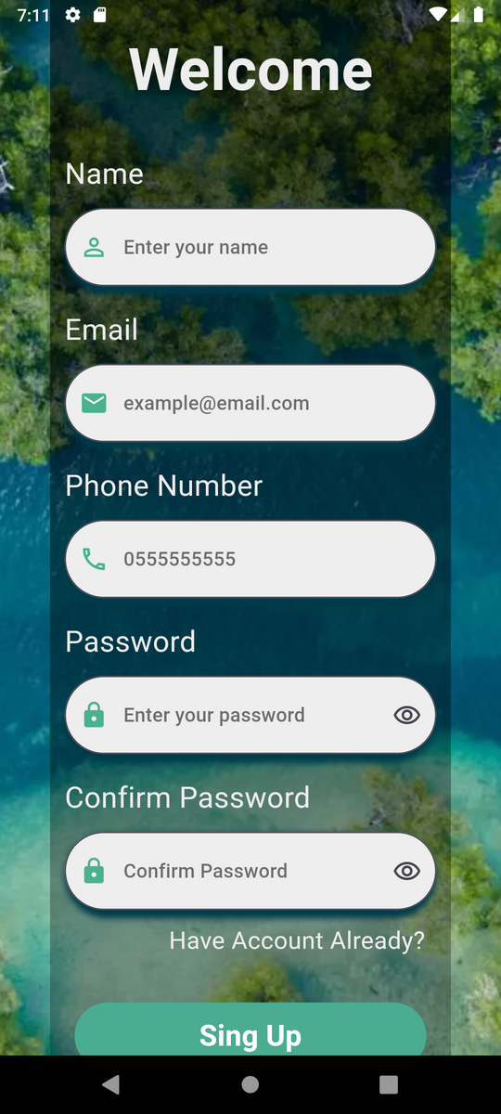
SAUDI GREEN APP

Slide 14
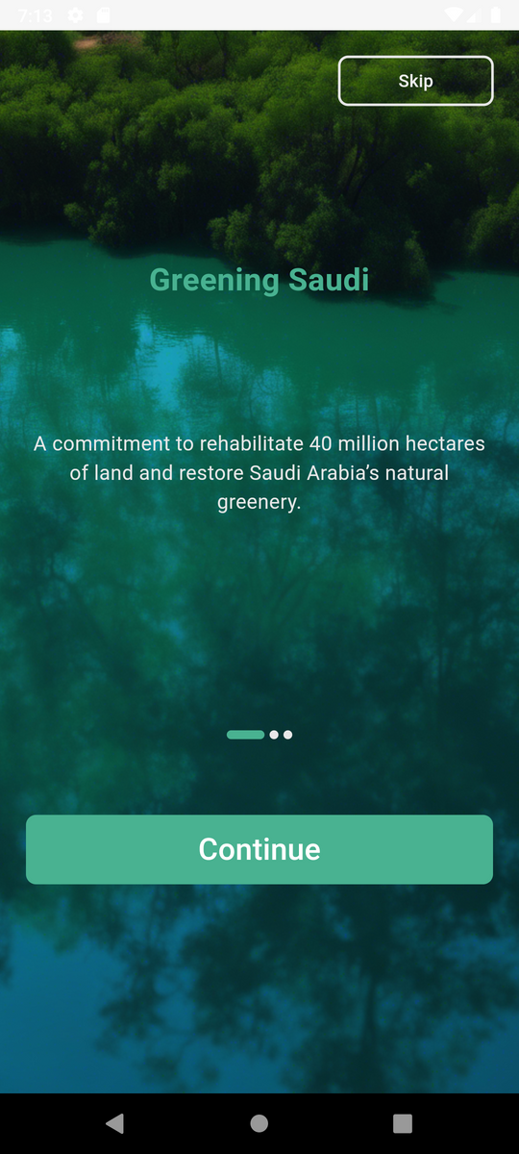
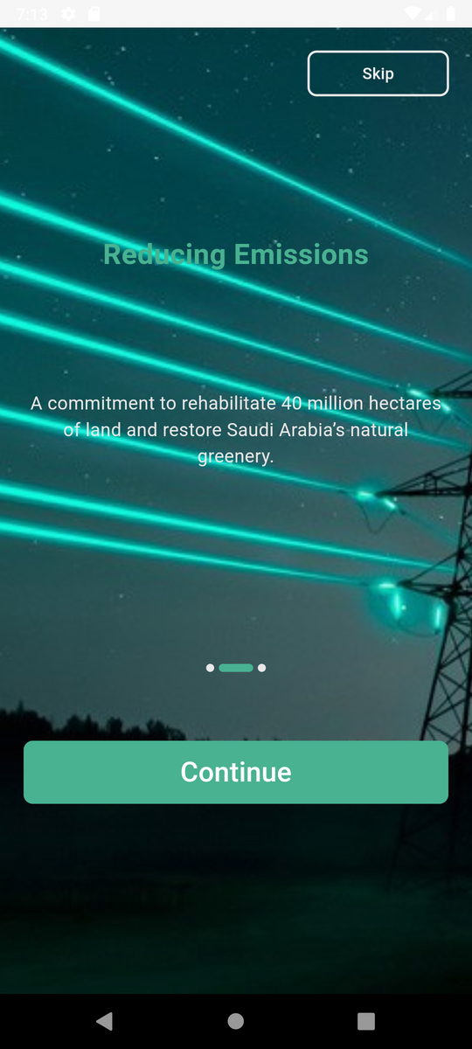
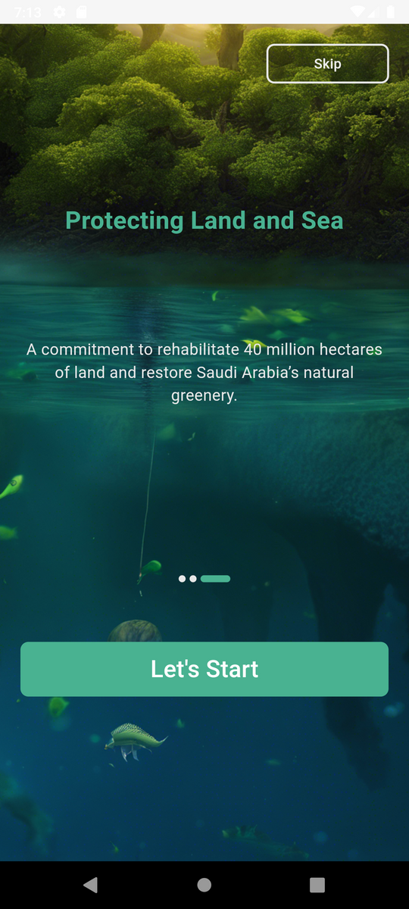
SAUDI GREEN APP: ONBOARDING

Slide 15
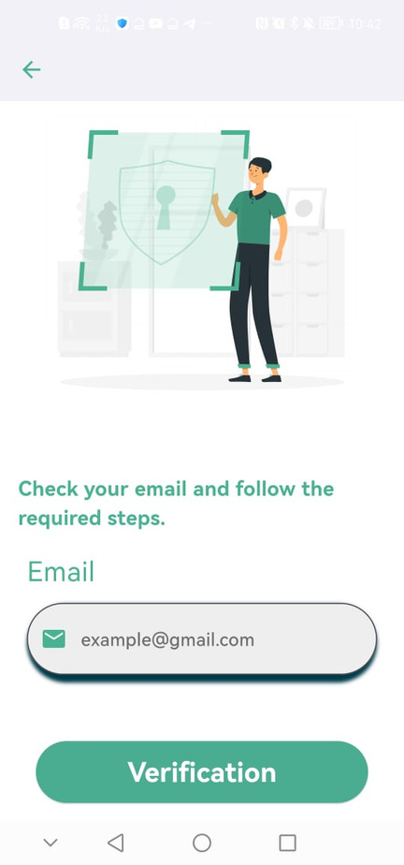
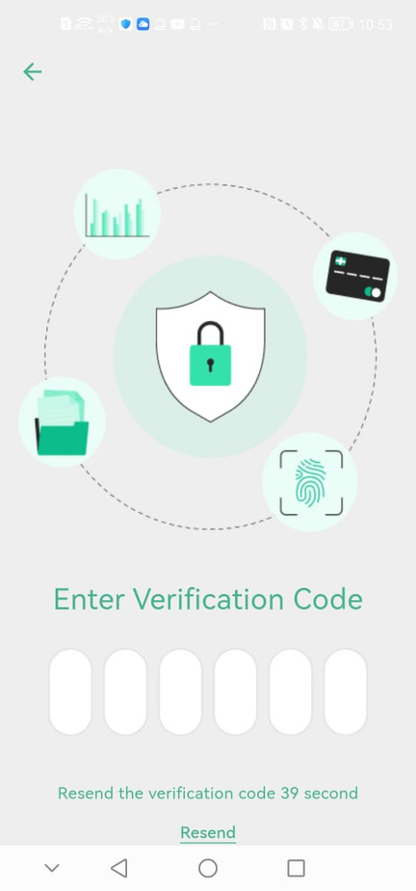
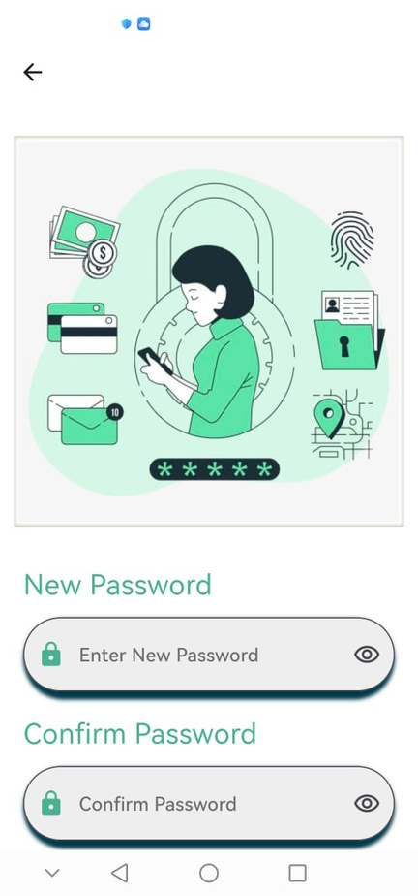
SAUDI GREEN APP: RESET PASSWORD

Slide 16
SAUDI GREEN APP: EVENT FLOW

Slide 17
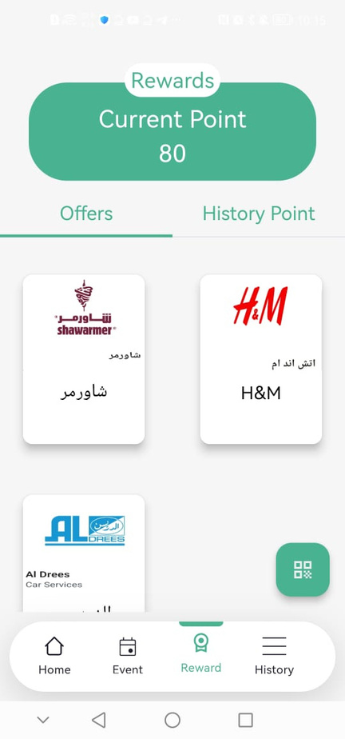
SAUDI GREEN APP: REWARD FLOW

Slide 18
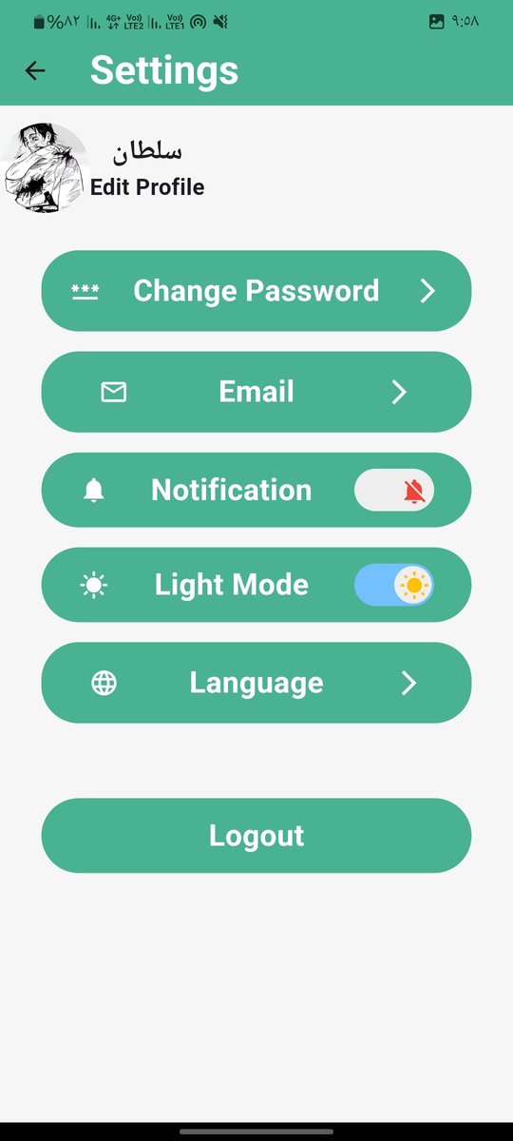
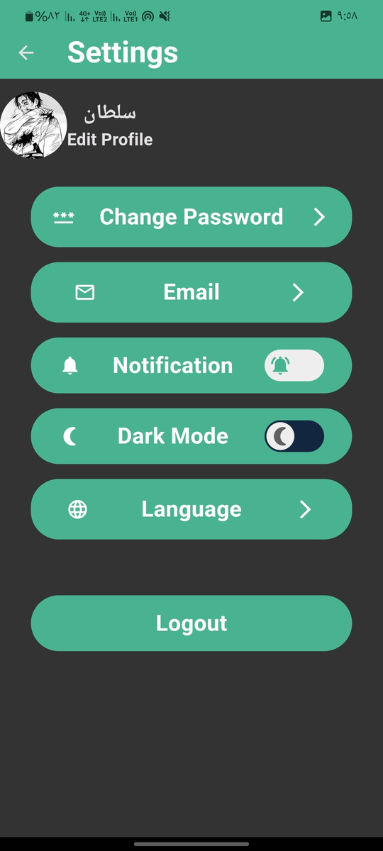
SAUDI GREEN APP: DARK MODE

Slide 19
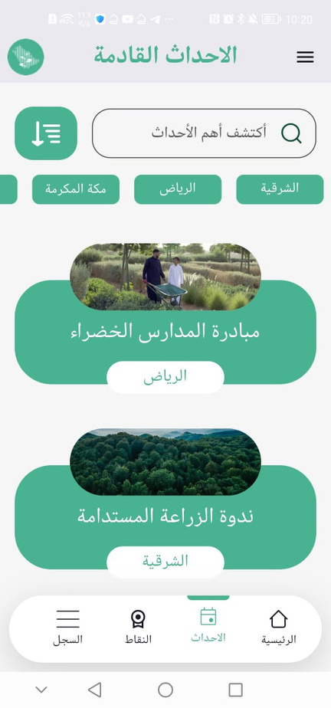
SAUDI GREEN APP: ENGLISH & ARABIC

Slide 20
DEMO:
SAUDI GREEN APP

Slide 21
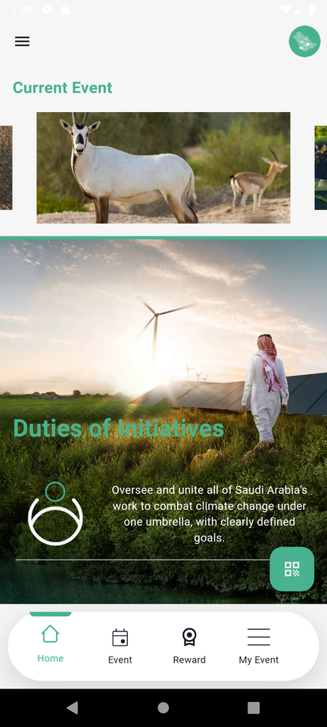
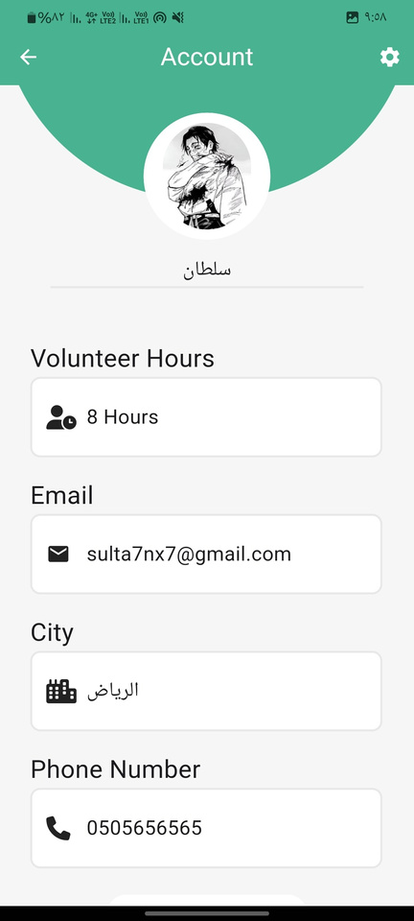
THANKS FOR
WATCHING
SAUDI GREEN APP

Slide 22

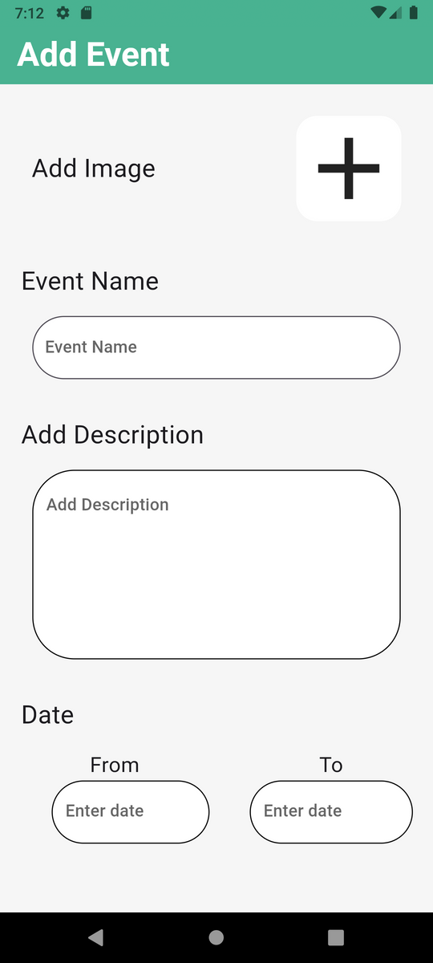
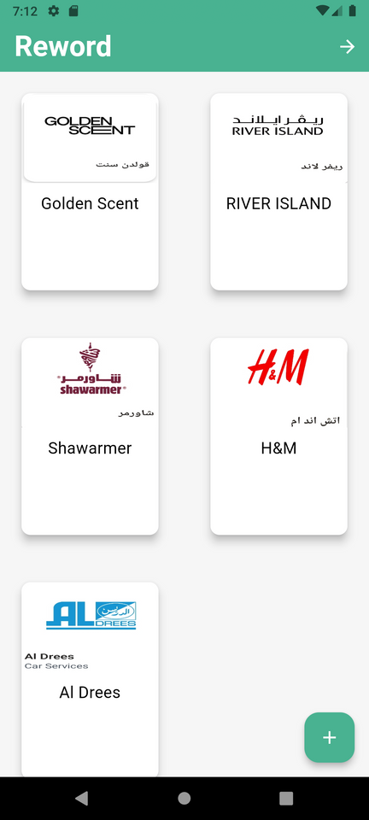
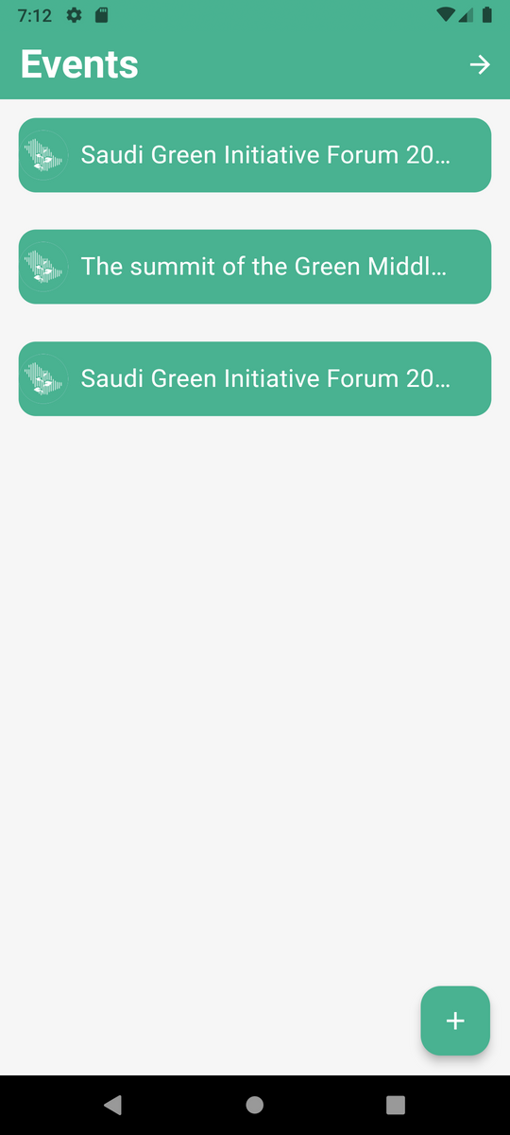
Admin Perspective
OPTIMIZING OPERATIONS

Slide 23
SAUDI GREEN APP: CONTROL PANEL

Slide 24
SAUDI GREEN APP: EVENT SYSTEM

Slide 25
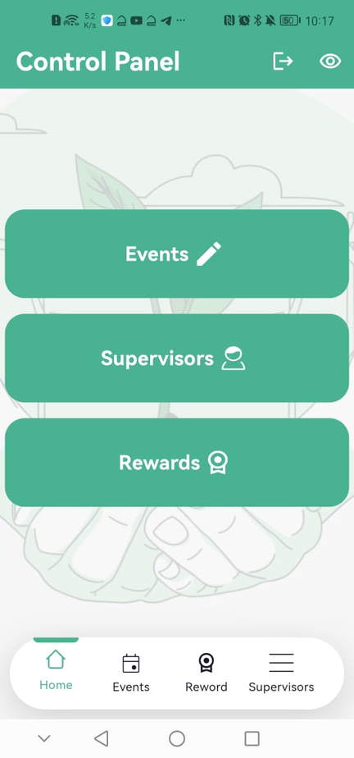
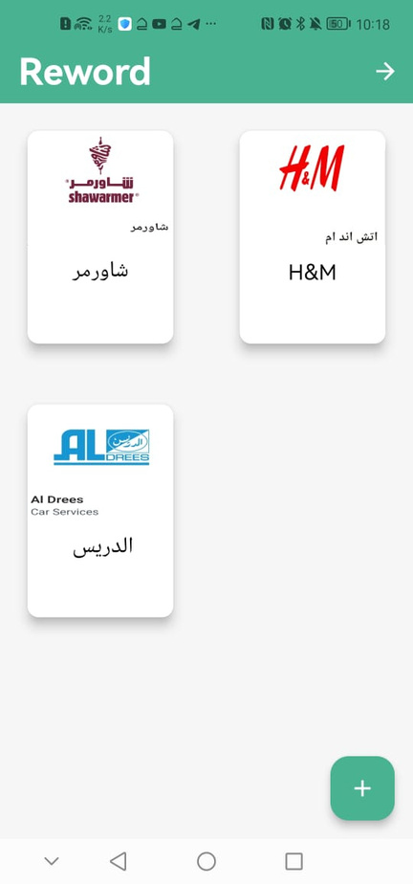
SAUDI GREEN APP: REWARD SYSTEM

Slide 26
SUPERVISE PERSPECTIVE

Slide 27
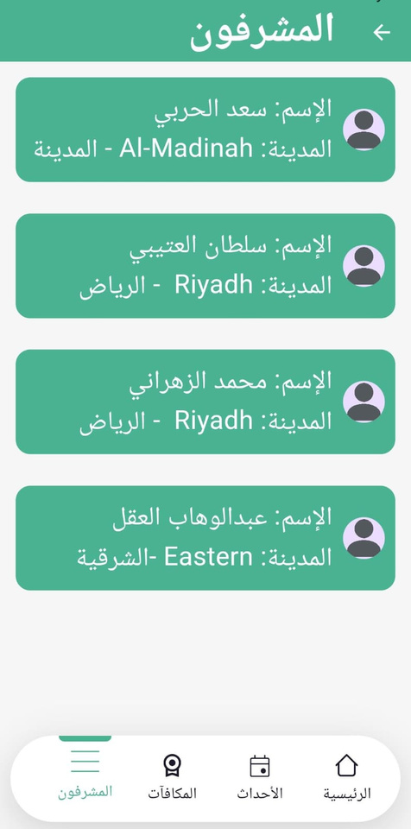
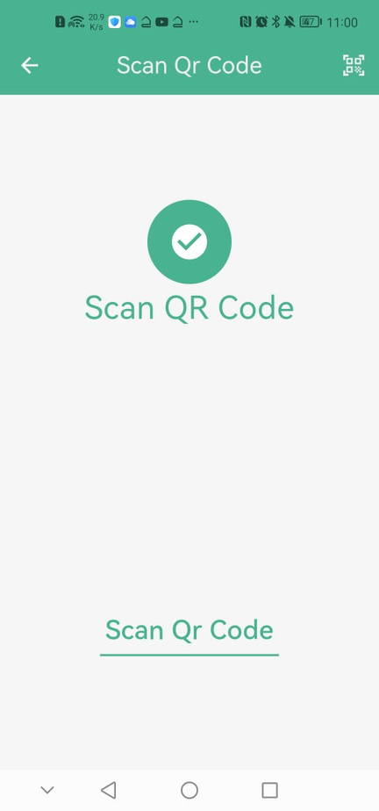
SAUDI GREEN APP: REWARD SYSTEM

